Slide 1

Fashion STORE ANNUAL REPORT ANALYSIS
PRESENTED BY – Ankit vikram singh
LinkedIn Profile -

Slide 2

OBJECTIVES
Fashion Store, a reputable retail establishment, aims to delve deeper into its sales performance throughout the year 2024. This endeavor is not merely about crunching numbers; it's about extracting meaningful insights that will empower the store's owners to make informed decisions, understand customer behaviors, and strategically plan for increased sales in 2025.
Fashion Stores is poised to elevate its competitive edge, foster stronger customer relationships, and achieve new heights of success in 2025 and beyond

Slide 3

Analytical Focus: Key Questions for Sales Data Analysis
Compare the sales and orders using single chart
Which month got the highest sales and orders
Who purchased more between men and women in 2024
What are the different orders status in 2024
List of top 5 states contributing to the sales
Relation between age and gender based on number of orders
Which channel is contributing to maximum sales
ANSWER
ANSWER
ANSWER
ANSWER
ANSWER
ANSWER
ANSWER

Slide 4

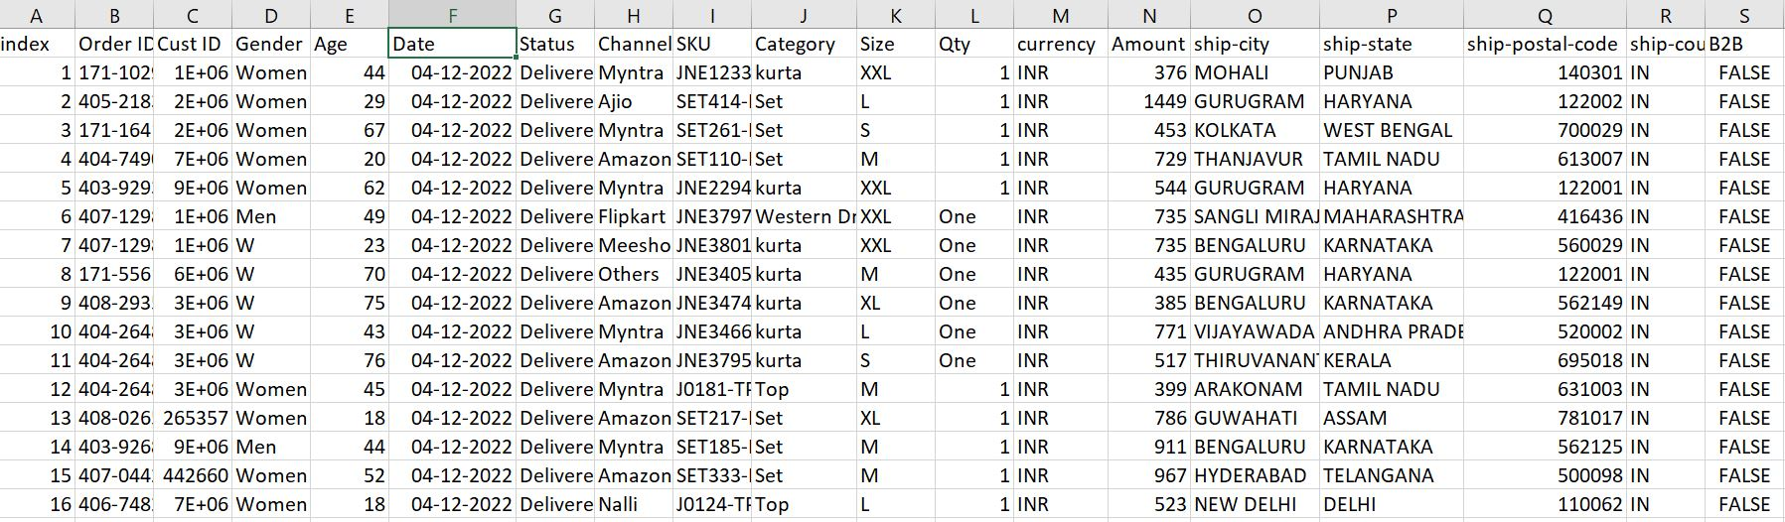
RAW DATA
ROWS | COLUMNS
31047 | 21

Slide 5

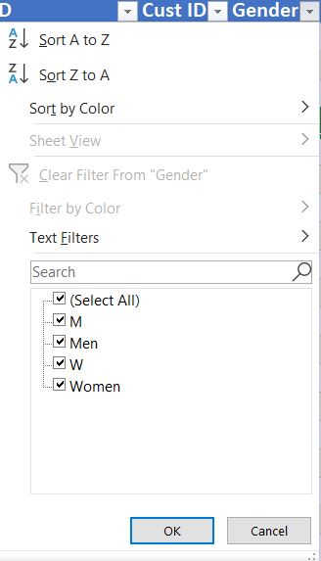
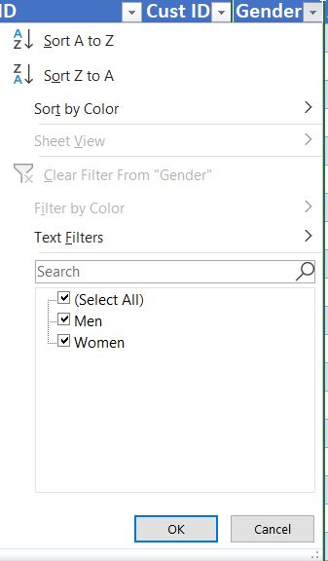
DATA CLEANING
Checked null values :- There is no null values
BEFORE
I've optimized gender representation swiftly by utilizing the replace function, seamlessly replacing 'M' with 'Men' and 'W' with 'Women' using the CTRL + F shortcut
AFTER

Slide 6
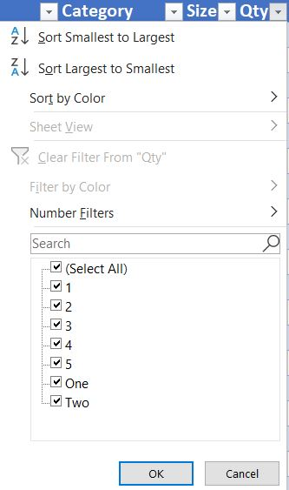
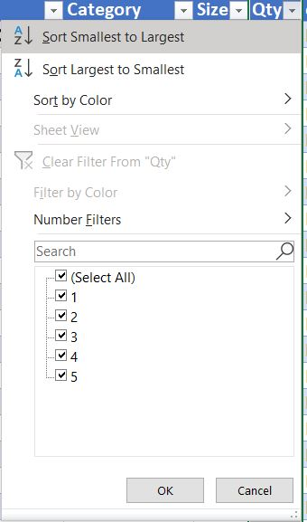
DATA CLEANING
Checked null values :- There is no null values
BEFORE
I've optimized QTY Column swiftly by utilizing the replace function, seamlessly replacing ‘One' with ‘1' and ‘Two' with ‘2' using the CTRL + F shortcut
AFTER

Slide 7

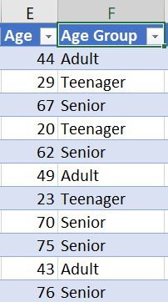
DATA PROCESSING
I've introduced a new column called 'Age Group' that categorizes individuals based on their age range. Those aged over 50 are classified as 'Senior', individuals aged between 30 and 49 fall into the 'Adult' category, and those under 30 are labeled as 'Teenager'. This classification system was implemented using IF functions for efficient organization and analysis.
EXCEL FORMULA
=IF(E2>=50,"Senior",IF(E2>=30,"Adult","Teenager"))

Slide 8
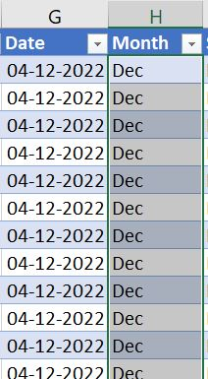

DATA PROCESSING
I've derived a 'Month’ name column by extracting the month information from the date column using the TEXT function. This method enables clearer analysis and visualization based on monthly trends.
EXCEL FORMULA

Slide 9

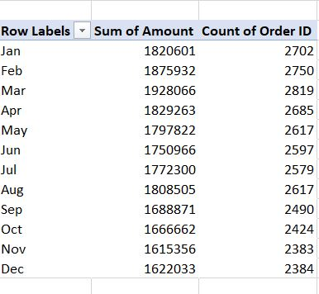
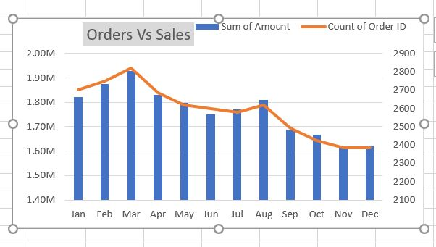
DATA ANALYSIS
Orders Vs Sales
PIVOT TABLE
PIVOT CHART

Slide 10
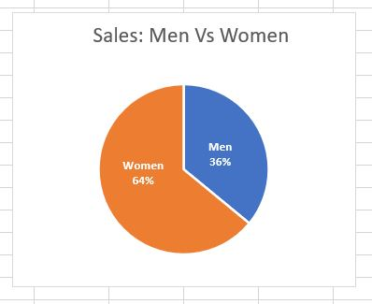
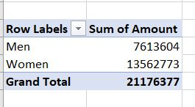
DATA ANALYSIS
Men Vs Women
PIVOT TABLE
PIVOT CHART

Slide 11
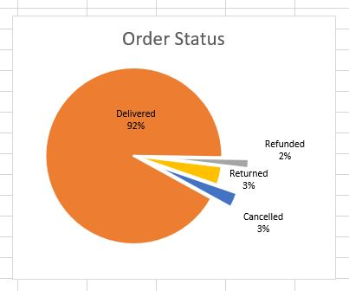
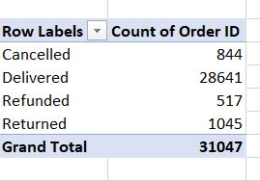
DATA ANALYSIS
Order Status
PIVOT TABLE
PIVOT CHART

Slide 12
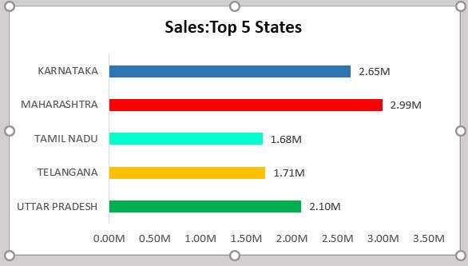
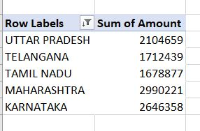
DATA ANALYSIS
Sales: Top 5 States
PIVOT TABLE
PIVOT CHART

Slide 13
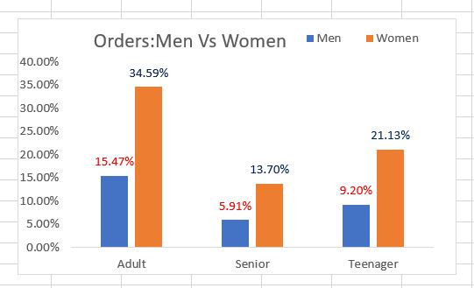
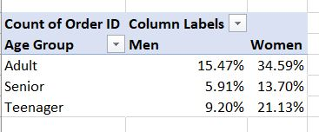
DATA ANALYSIS
Age Group: Men Vs Women
PIVOT TABLE
PIVOT CHART

Slide 14
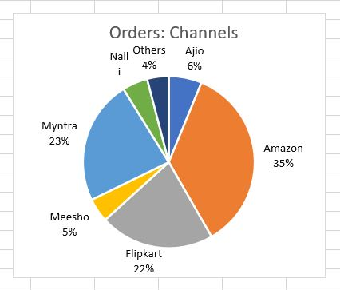
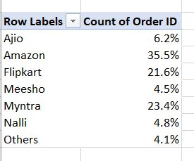
DATA ANALYSIS
Orders: E-Commerce Platform
PIVOT TABLE
PIVOT CHART

Slide 15
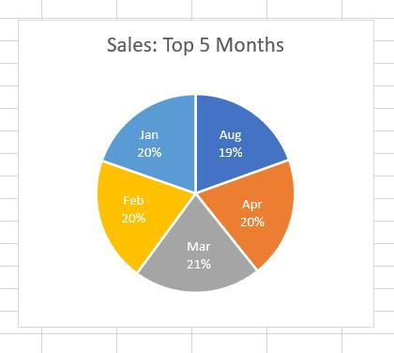
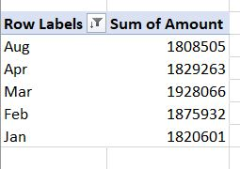
DATA ANALYSIS
Sales: Top 5 Months
PIVOT TABLE
PIVOT CHART

Slide 16
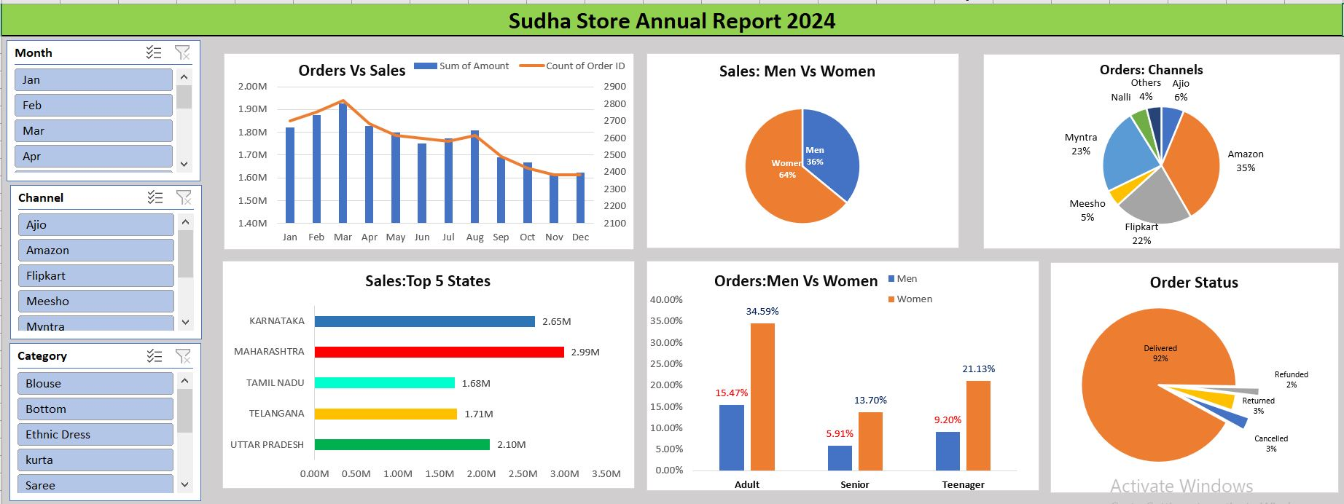
FINAL INTERACTIVE REPORT

Slide 17

INSIGHTS
Month with highest sales - MARCH
Which gender buys more – FEMALE
Most of the order is delivered (92%),Which means there is no problem in delivery system
State with highest sales – MAHARASHTRA
Age Group with highest sales – ADULT FEMALE (Age Between 30-49)
Channels from which highest sales – AMAZON (35%)
More than 80% of sales is done in Amazon , Myntra , Flipkart

Slide 18
Final conclusion to improve Sudha Store Sales
To enhance Sudha Store sales, we propose targeting women customers aged 30-49 residing in Maharashtra, Karnataka, and Uttar Pradesh. This can be achieved by strategically showcasing advertisements, offers, and coupons on popular e-commerce platforms such as Amazon, Flipkart, and Myntra. By leveraging these platforms, we can effectively reach our target demographic and drive sales growth.

